Slide 1
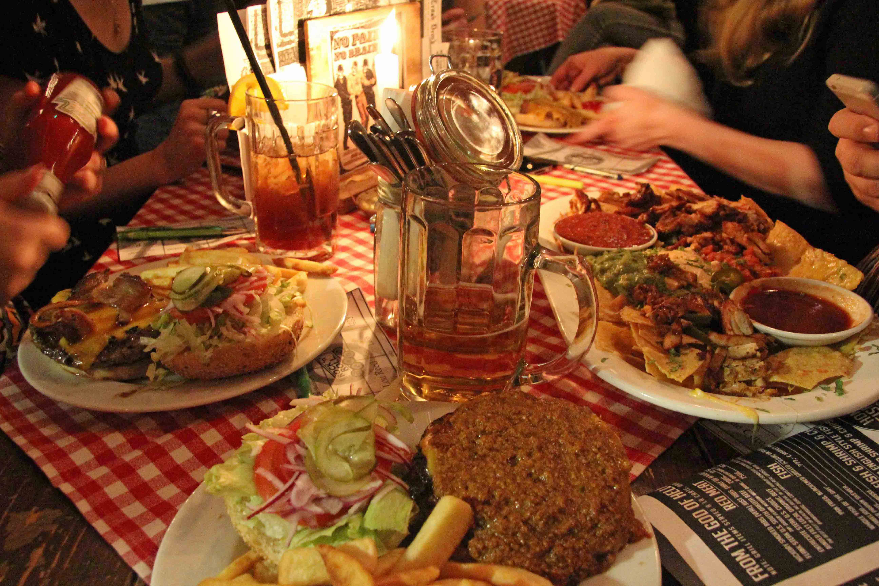
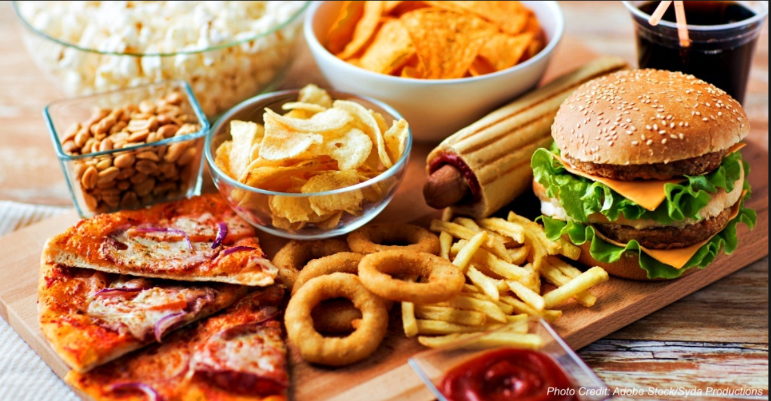
Fast Food Restaurant Chains in USA

Slide 2
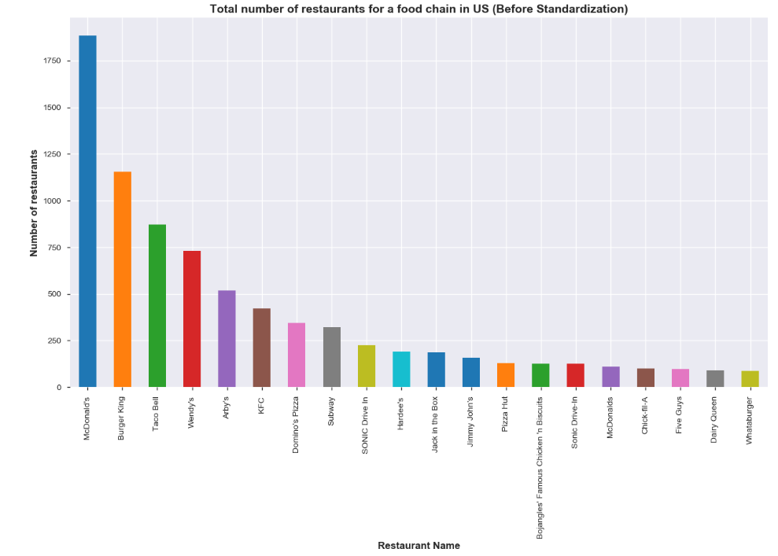
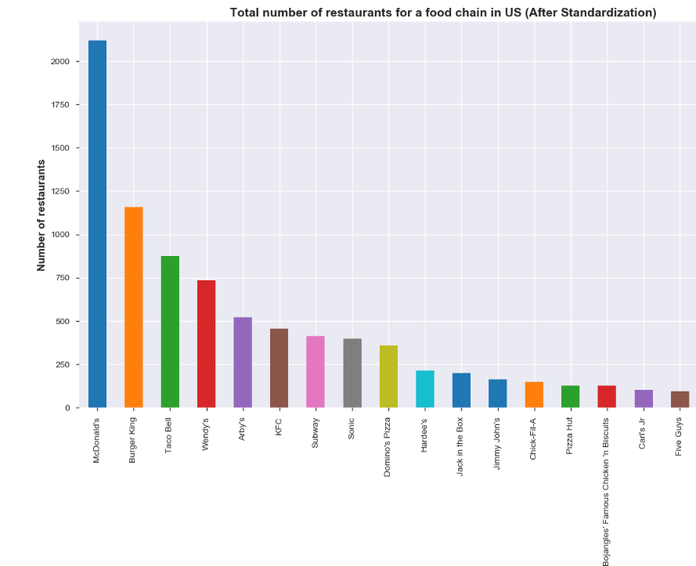
Standardizing the Restaurant Names
Observation:
Here, we see that standardizing the Restaurant names made such a huge impact on the number of restaurants.
For e.g., number of McDonald's restaurants increased from 1886 to 2121 and Sonic from 226 to 399.

Slide 3
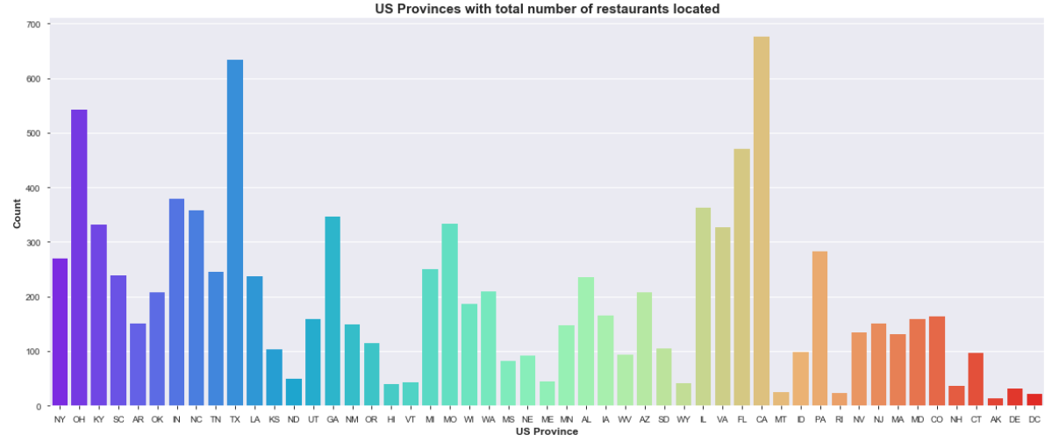
All US Provinces with total number of restaurants located there
Observation: CA has the maximum number of restaurants, followed by TX, OH and FL.

Slide 4
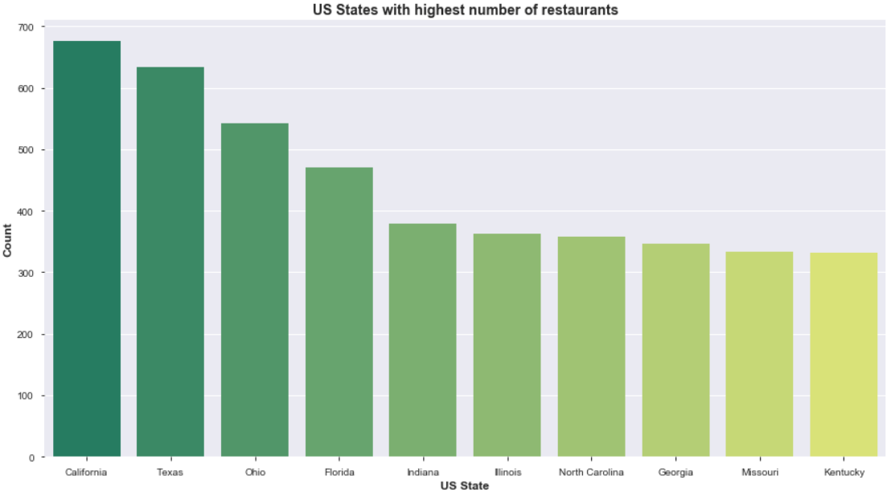
Top 10 US States with highest number of food chains
Observation:
California has the maximum number of restaurants, followed by Texas, Ohio and Florida.
Indiana, Illinois, North Carolina, Georgia, Missouri and Kentucky are quite comparable.

Slide 5
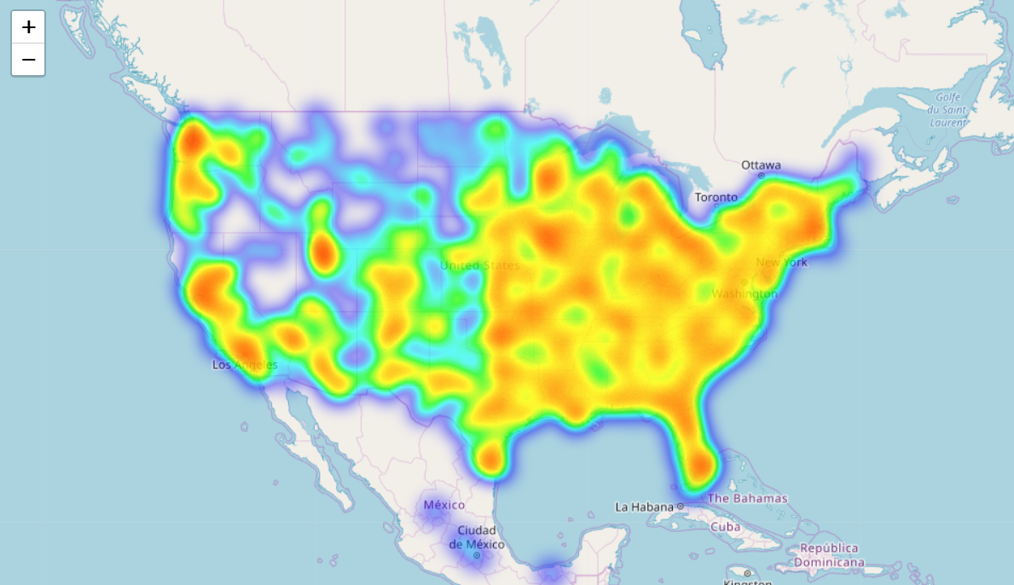
Which part of the US has more number of restaurants?
Observation:
States in the East coast of US have more number of restaurants than other parts of the country.
California is the only state in West coast that has a considerable number of fast food chain restaurants. Rest of the states which are in top 10 list lie towards the East coast:
Texas, Ohio, Florida, Indiana, Illinois, North Carolina, Georgia, Missouri and Kentucky – They all lie in East Coast

Slide 6
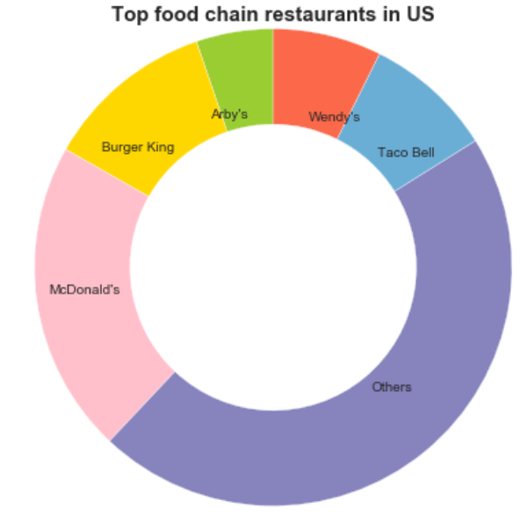
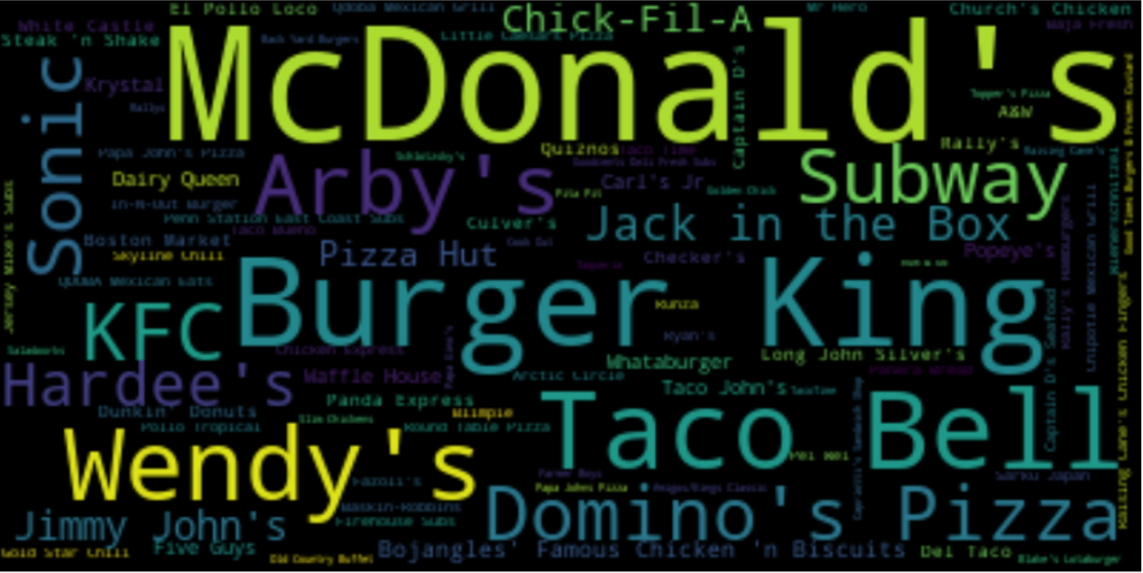
Food chain with largest number of restaurants in US
Word cloud depiction:
Observation:
McDonald's is the most popular fast food chain in US, followed by Burger King, Taco Bell and Wendy's.
McDonald's, Burger King, Taco Bell, Wendy's and Arby's constitute to more than 50% of all the restaurants in the US.

Slide 7
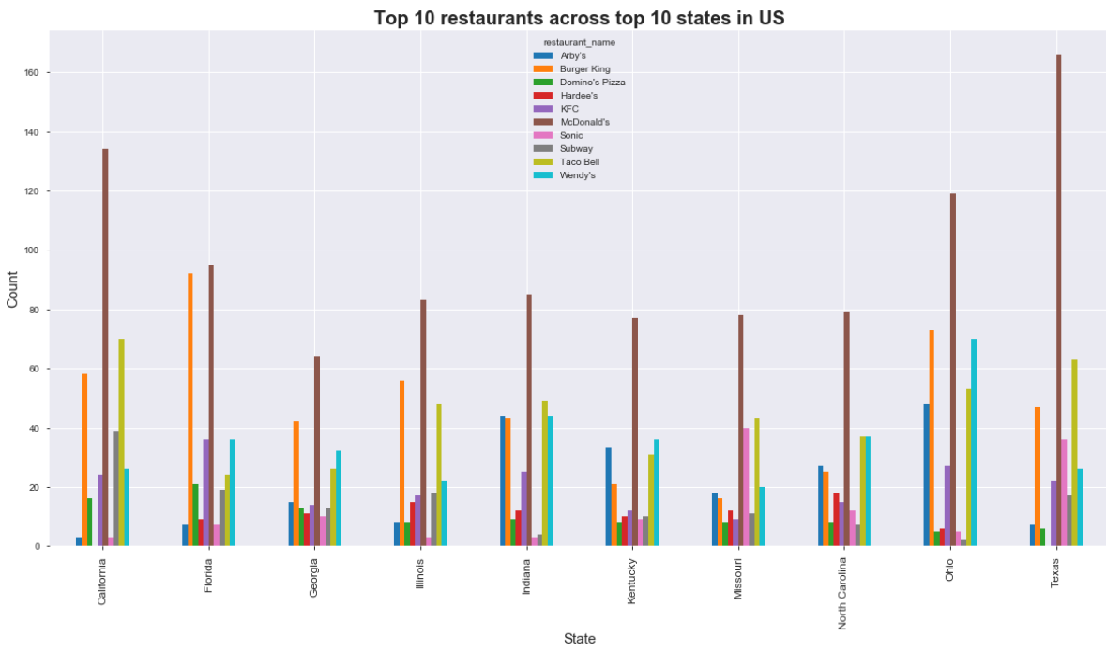
Distribution of different fast food chains amongst the states in US
Observation:
As seen earlier, California has more number of restaurants than Texas, but Texas has the highest number of McDonald's.
Similarly, Florida has the highest number of Burger King restaurants, followed by Ohio and California.

Slide 8
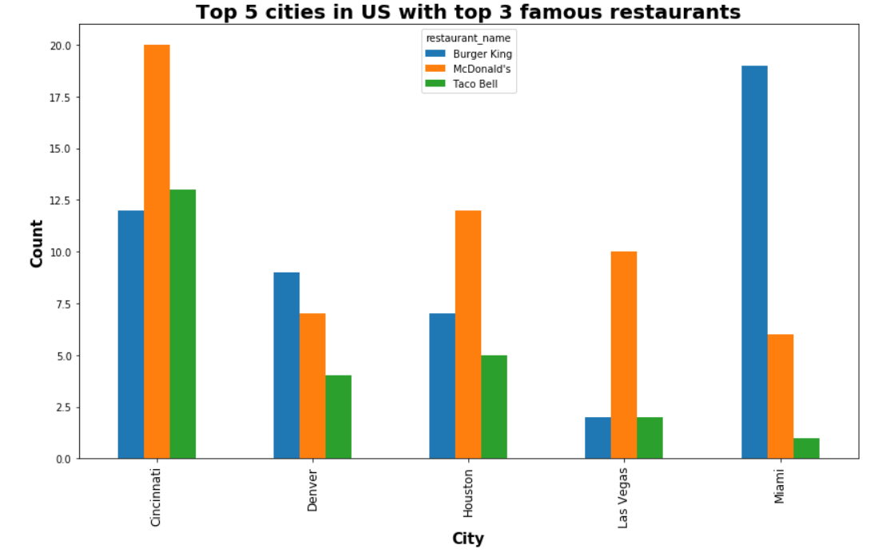
Top 5 US Cities with top 3 famous fast food restaurant chains located there
Observation:
In Cincinnati, McDonald's is most famous, while in Miami Burger King is way more famous than McDonald's or Taco Bell.
In Houston and Las Vegas too, McDonald's is more famous, whereas Taco Bell and Burger King restaurants are similar in number.

Slide 9
THANK YOU

